Slide 1
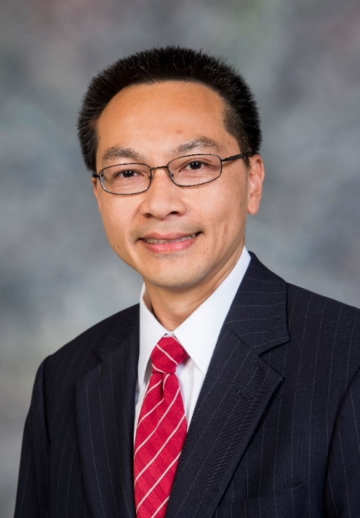
Engineering the Reduction Reaction of Nitrate Oxyanions
学术报告
报告人：Michael S. Wong, Ph.D.
Professor and Chair of the Department of Chemical and Biomolecular Engineering, Rice University, USA
时间：2018年9月27日 上午9:00-10:00
地点：工物馆324教室
摘要：
One of the central tenets in the field of heterogeneous catalysis is the surface catalytic properties of a material are controlled by its nanostructure. By understanding the structure-property connection at increasingly fine detail, one can create materials to improve our understanding of chemical reactions at the molecular level, and to imbue them with enhanced catalytic performance (i.e., the three S's of speed, selectivity and stability). Through a synthesis-structure-property approach, recalcitrant contaminants of water can be degraded or even upgraded successfully. I discuss the progress of catalytic reduction of oxyanions using metallic nanostructures, and provide the latest learnings on indium-decorated Pd nanoparticle catalysts for treating nitrate oxyanions.
报告人简介：
Dr. Michael S. Wong is Professor and Chair of the Department of Chemical and Biomolecular Engineering at Rice University. He is also Professor in the Department of Chemistry, Department of Civil and Environmental Engineering, and Department of Materials Science and NanoEngineering. He was educated and trained at Caltech, MIT, and UC Santa Barbara. His research program broadly addresses chemical engineering problems using the tools of materials chemistry, with a particular interest in energy and environmental applications ("catalysis for clean water") and an emphasis on understanding synthesis-structure-property relationships in heterogeneous catalysis. His group is highly productive (grants exceeding $15MM, 120+ publications, 20+ pending/issued patents, 300+ presentations, Google scholar h-index of 48, and citations of >9900). Current research activities and interests are (i) structure-property analysis of palladium-on-gold catalysts; (ii) metal-on-metal nanoparticle synthesis; (iii) petroleum upgrading chemistry, (iv) treatment of dioxane, nitrate, fluorocarbons, and chlorocarbons from water; and (v) microcapsule self-assembly and applications.
讲座联系人：罗国华（化工系反应工程教研室）
电话：62788994，Email：luoguoh@tsinghua.edu.cn

