Slide 1

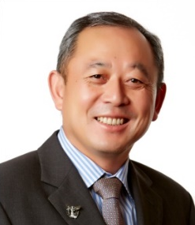
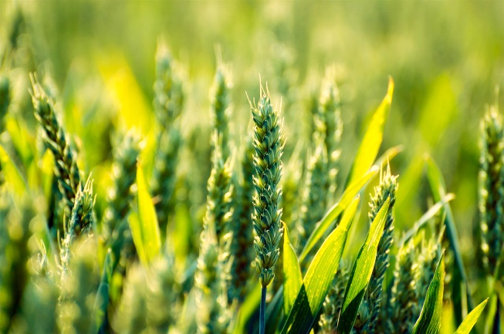
学术报告
Healthy Soil for Healthy Food
报告人： Prof. Deli Chen
报告时间：2018年11月2日 10:30-11:30
报告地点：工物馆332
内容简介：
Soil degradation is a major threat to international food security. Faced with soil degradation and population growth, Australia and China have come together to establish a Joint Research Centre—Healthy Soils for Sustainable Food Production and Environmental Quality, to address food security and sustainable soil management. The Centre is dedicated to 1) delivering new solutions to challenges in sustainable agricultural management; 2) training early and mid-career-researchers through bilateral study opportunities; 3) facilitating collaboration between stakeholders in Australia and China. Leading the Joint Research Centre, the Soils and the Environment Research Group at the University of Melbourne seeks to understand the impacts of agricultural management on soil processes and develop technology to improve agricultural sustainability. The Group carries out a range of fundamental and applied research with the aim to help policy makers, industry partners and farmers make evidence-based decisions.
报告人简介：
Professor Deli Chen is the discipline leader in Soil and the Environment Research Group, Research Director of the School of Agriculture and Food, China Director of the Faculty of Veterinary and Agricultural Sciences, and International Collaborative Research Advisor at the University of Melbourne. He is also the Director of the Australia China Joint Research Centre, Healthy Soils for Sustainable Food Production and Environmental Quality. He is a Member of Executive Committee for the SCOPE-IGBP on International Nitrogen Initiative (INI).
Professor Chen has expertise in water and nutrients dynamics in plant-soil systems; GIS based agroecosystem modelling and decision support systems for optimal irrigation and fertilizer management; and the measurement and modelling of greenhouse gases emissions from land sources and impact of climate on agro-ecosystems. Professor Chen has authored over 250 journal publications, majority in the top journal of the discipline. He has successfully led an internationally recognised research team attracting more than $30 million in the past 15 years in competitive research grant funding from government and industry partners as well as international fund over the previous ten years. Professor Chen was awarded the JA Prescott Medal for excellence and achievement in the field of soil science by the Australian Society of Soil Science in 2010, a Fellow of Soil Science Society of America in 2015, a Fellow of Soil Science Australia in 2015 and a Fellow of American Society of Agronomy in 2017, the highest recognitions given by these societies.

