Slide 1

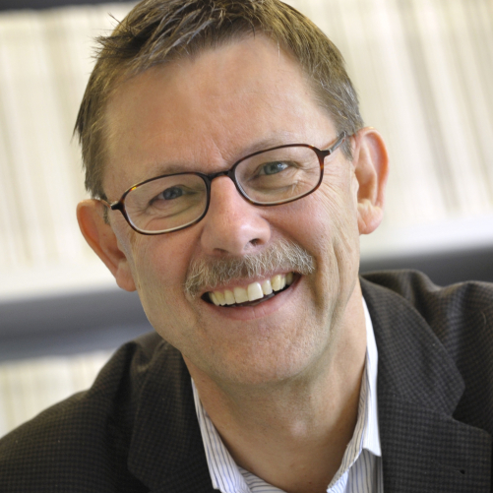
Industrial Homogeneous Catalysis Course
授课人: Prof. Johannes G. de Vries
时间： 2019.6.17-6.19
地点：蒙民伟南楼618会议室
Current Organization:
Head of Department
Catalysis with renewable resources
Leibniz Institute for Catalysis, Rostock, Germany
Current Research Interests :
Catalytic conversion of renewable resources and platform chemicals.
Catalytic conversion of platform chemicals into monomers for polymers such as butadiene, adiponitrile, caprolactam, adipic acid, etc.
Use of microreactors and flow chemistry.
Selective conversions on sugars.
Mechanism of homogeneous transition metal catalyzed reactions.
Teaching Course:
Date | Time | Topics
6.17 | 9:30 -11:30 | Introduction of Homogeneous Catalysis and CO-Chemistry
6.18 | 9:30 -11:30 | CO-Chemistry, Hydrocyanation and Hydrogenation
6.18 | 15:20-17:50 | Asymmetric Hydrogenation and Reactions on the SP² Carbon
6.19 | 9:30 -11:30 | Oxidation (Bulk) and Process Development

