Slide 1
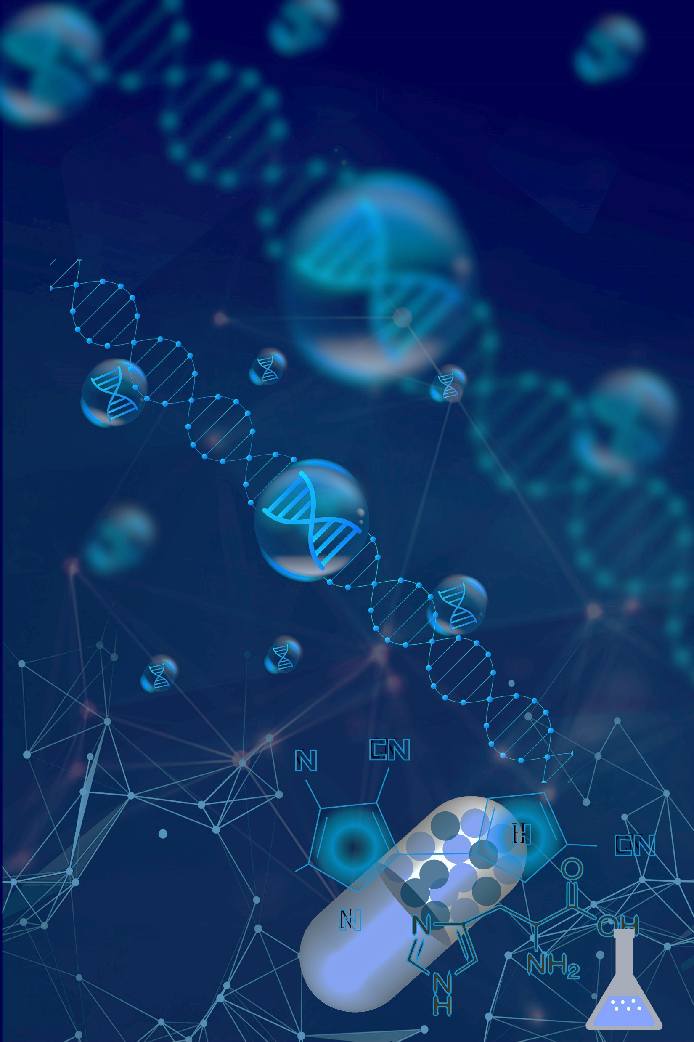



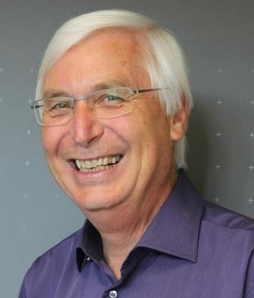
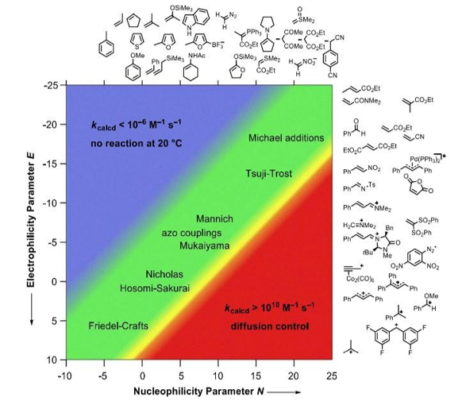
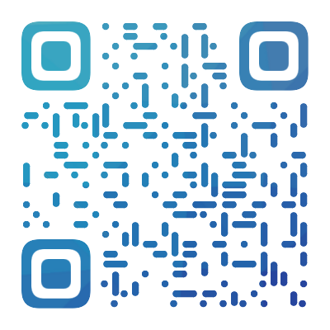
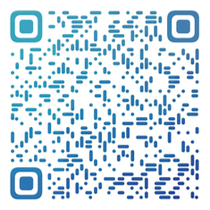
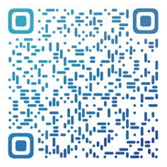
  机理与合成论坛
  Mechanism and Synthesis Forum
Quantifying Polar Organic Reactivity by Nucleophilicity and Electrophilicity Scales
2021 MAS Forum No.4
Prof. Herbert Mayr,Chemistry Department,Ludwig-Maximilian-Universitaet Muenchen(LMU),Germany
November 24,2021 16:00-17:30
Room S527，Mong Man Wai Building of Science and Technology,Tsinghua University
Mayr is a member of the Bavarian Academy of Sciences and the German National Academy of Sciences.In 2019,he received the James-Flack-Norris Award for Physical Organic Chemistry of the American Chemical Society for his work on the development of nucleophilicity and electrophilicity scales which can be applied for planning organic syntheses,modelling carbocationic polymerizations,and elucidating reaction mechanisms.
Abstract
This lecture will describe the development of nucleophilicity and electrophilicity scales in a historical view,as well as recent progress in quantifying polar organic reactivity using eq(1).
lgk_{20°C} = s_{N}(E + N) (1)
By using para-and meta-substituted benzhydr yliumions (Ar₂CH⁺) and structurally related quinone methides as reference electrophiles which differ widely in reactivity,we have created the most comprehensive nucleophilicity scales presently available.
直播二维码
邃瞳科学云
B站
视频号

